Slide 1
Lesson 7: Version Control (Git vs GitHub)

Slide 2
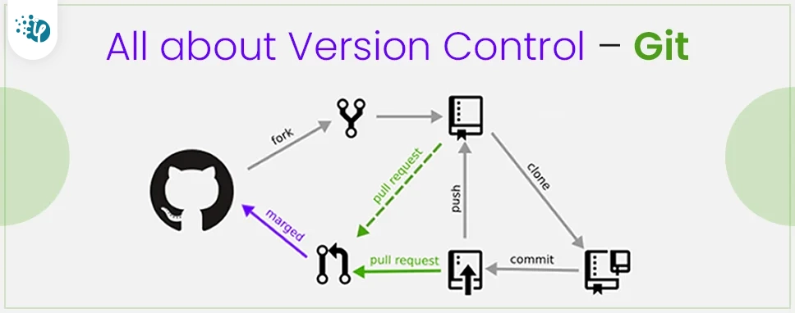
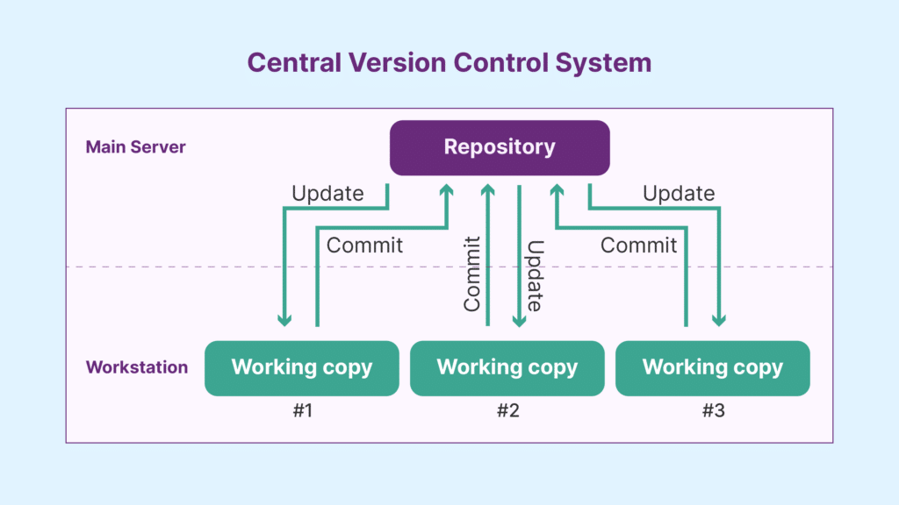
What is Version Control?
Version control - also known as source control or revision control - is an important software development practice for tracking and managing changes made to code and other files. It is closely related to source code management.

Slide 3
What is Version Control?
Version control - also known as source control or revision control - is an important software development practice for tracking and managing changes made to code and other files. It is closely related to source code management.
Key Concepts:
Repository (Repo): This is a storage space where your project lives. It can be local (on your machine) or remote (on a server like GitHub).
Commit: A commit is a snapshot of your project at a specific point in time. Each commit has a unique ID and contains metadata, such as the author's name, timestamp, and a message describing the changes.
Branch: A branch is a separate line of development. By default, Git has a branch called "main" (or "master"). You can create new branches to work on features or fixes without affecting the main codebase.
Merge: Merging is the process of integrating changes from one branch into another. This is often done when a feature is complete and ready to be included in the main codebase.
Clone: Cloning creates a local copy of a remote repository, allowing you to work on the project offline.
Pull and Push: Pull fetches changes from the remote repository and merges them into your local repository. Push sends your local commits to the remote repository, making them available to other collaborators.
Conflict: A conflict occurs when changes in different branches affect the same line in a file. Git will require you to manually resolve the conflict before completing a merge.
Staging Area: This is where you prepare changes before committing them. You can add or remove changes from the staging area, allowing you to control what goes into the next commit.

Slide 4
Git
Version control in Git is a system that allows multiple developers to work on the same project simultaneously without overwriting each other's changes. It tracks changes to files over time, enabling users to revert to previous versions, collaborate more effectively, and manage different branches of development.
Key Features:
• Local Version Control: Changes are tracked locally without a need for internet.
• Branching and Merging: Create branches for new features and merge them back without affecting the main code.
•Tracking Changes: Every change is saved with a unique ID, allowing you to revert to previous versions.
How to use Git in VS code:
Git

Slide 5
What is GitHub?
is a cloud- based hosting service for Git repositories. It's a platform for sharing code and collaborating with others.
Purpose:
GitHub provides a platform to store, manage, and collaborate on Git repositories in the cloud.
Installation:
GitHub is a web-based platform that you access through your web browser. To use GitHub, you only need to:
Create an account on GitHub (at github.com).
Install Git on your local computer if you plan to manage code with Git and connect it to GitHub.

Slide 6
What is GitHub?
is a cloud- based hosting service for Git repositories. It's a platform for sharing code and collaborating with others.
Key Features:
• Remote Collaboration: Share code with team members worldwide.
• Code Review and Pull Requests: Other developers can review your code changes, make comments, and suggest modifications.
• Project Management Tools: Issues, tasks, and project boards help organize project work.
Example Workflow:
Initialize a Git repository on your computer (git init).
Add and commit code changes locally (git add, git commit).
Push the repository to GitHub (git push origin main) to back it up or share it.

Slide 7
THANK YOU

